Slide 1
Nicholas Canan
Satisfaction
Development
Relationships
Empathy
Knowledge
Consistency
Kindness
Ethics

Slide 2
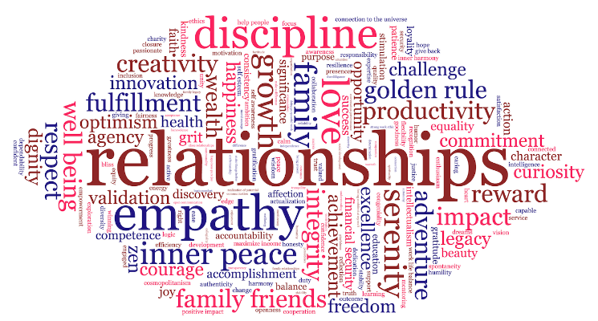

Slide 3
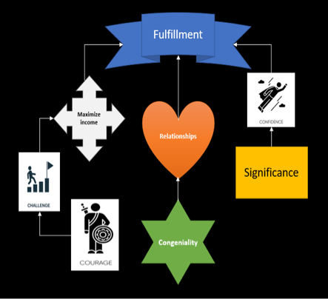
Ananya Vandan Agrawal

Slide 5
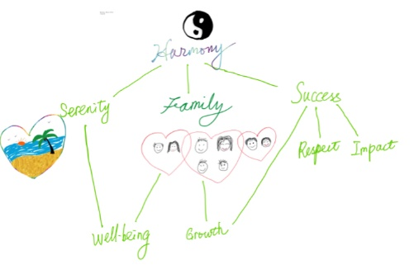
Bicheng Wu

Slide 7
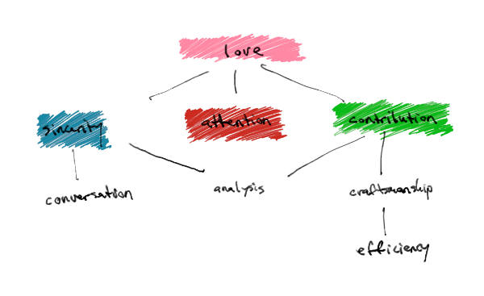
Chris Anthony

Slide 9
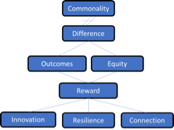
Brandon Best

Slide 11
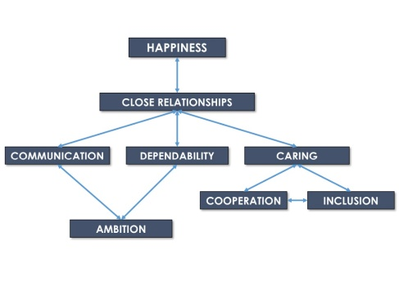
Elliott Brannon

Slide 13
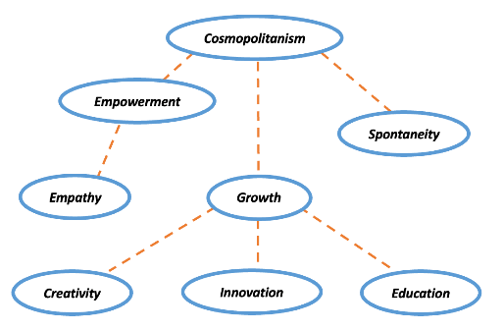
Michael Broderick

Slide 15
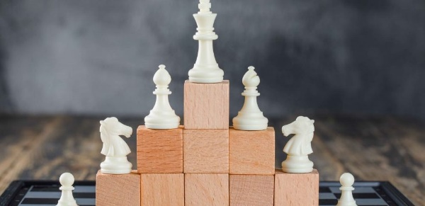
Weston Brooks

Slide 17
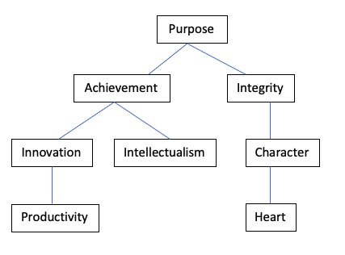
Anh-Quang Steve Bui

Slide 19
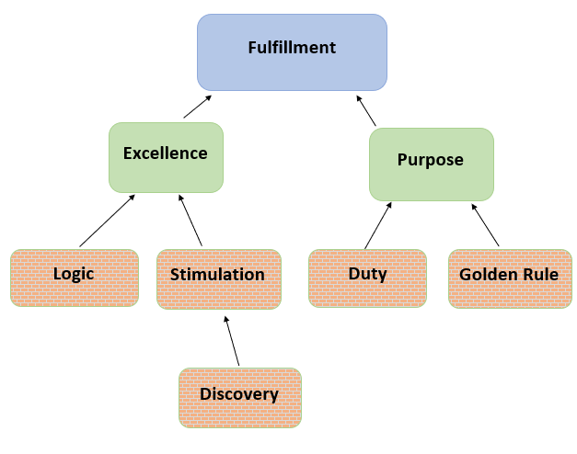
Robert Dunphy

Slide 21
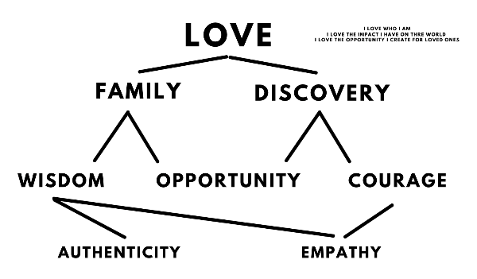
Michael Freyre

Slide 23
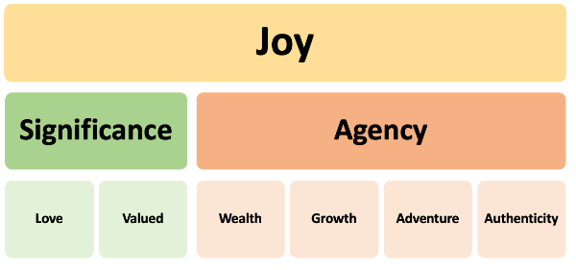
Devon Furlong

Slide 25
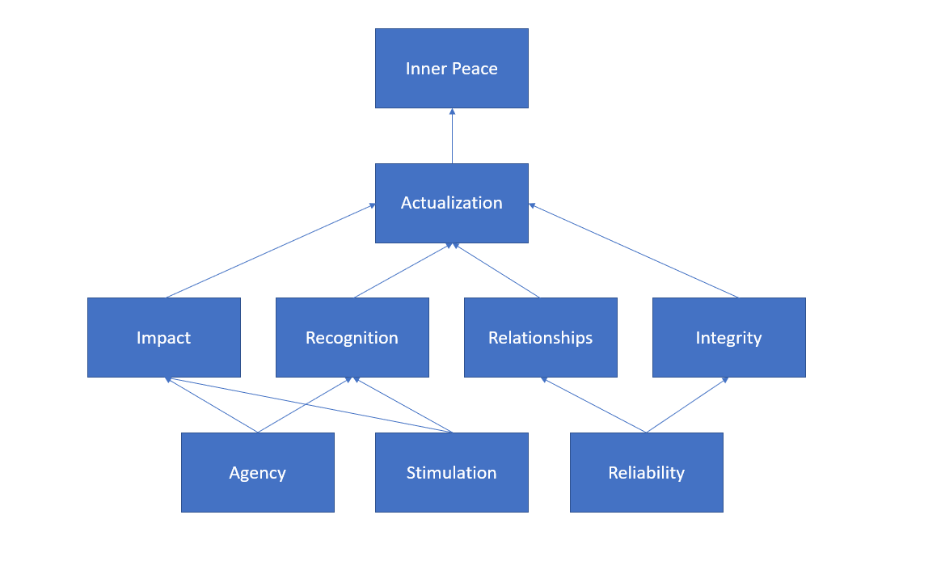
Max Garelick

Slide 27
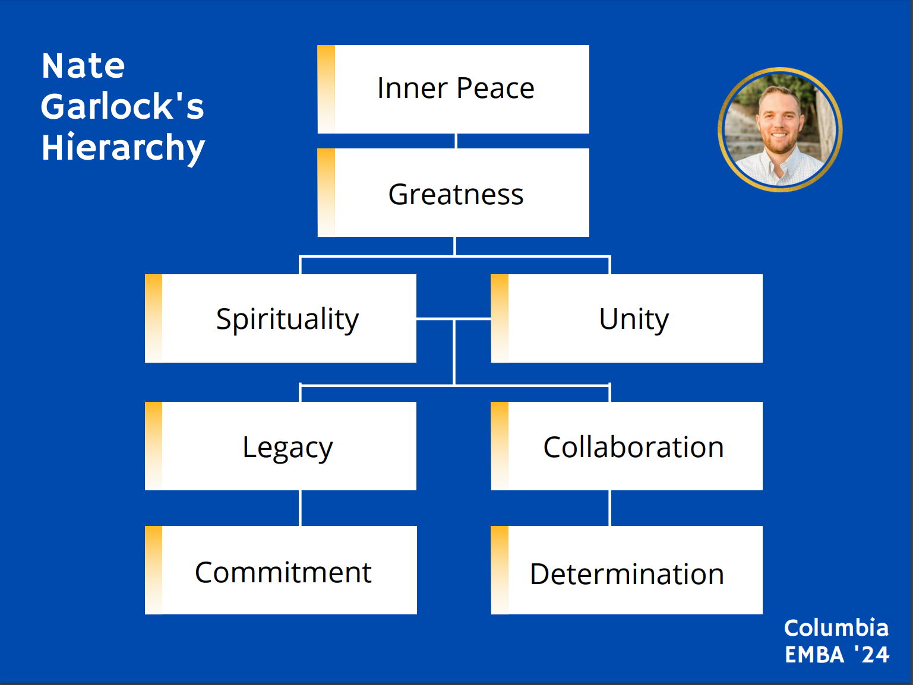
Nate Garlock

Slide 29
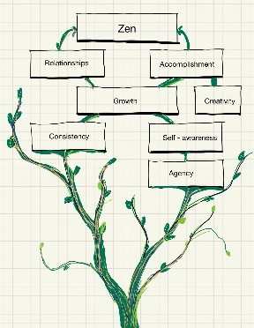
Max Garvin

Slide 31
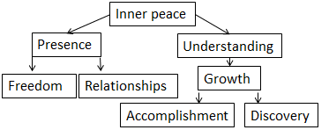
Benjamin Greenspan

Slide 33
Miku Hagihara
Stability
Family
Purpose
Validation
Respect
Opportunity
Integrity
Grit

Slide 35

Jacqueline Heitkamp

Slide 37
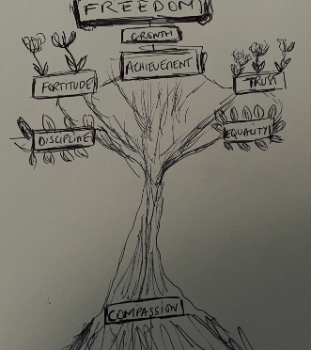
Alexandra Kubicz

Slide 39
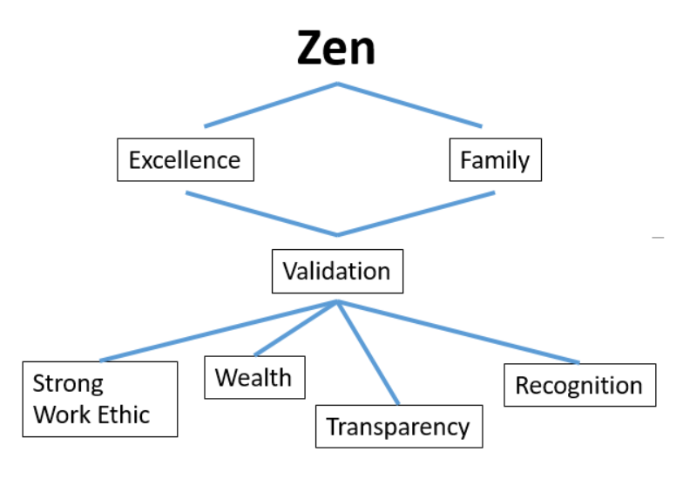
Nelson Liu

Slide 41
Lam Lu
Zen
Hope
Significance
Discovery
Growth
Stimulation
Golden Rule
Honesty

Slide 43
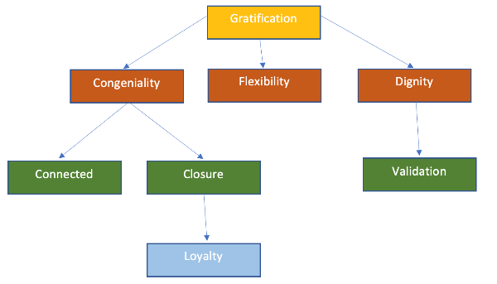
Kellie Lynch

Slide 45
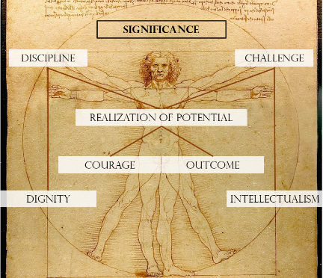
Michael Miller

Slide 47
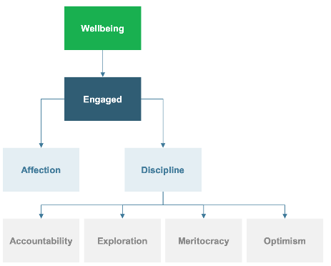
Ahmed Moussa

Slide 49
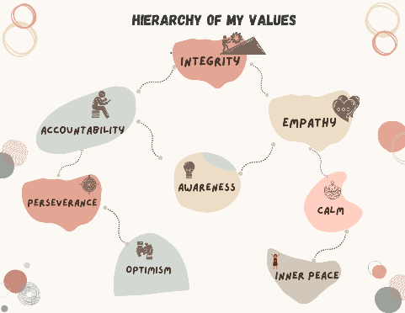
Sowmya Mupparaju

Slide 51
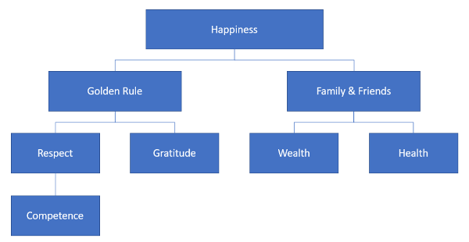
Alexander Oh

Slide 53
Ayako Okoshi
Quality
Family
Enthusiasm
Trust
Love
Active
Focus
Peace

Slide 55
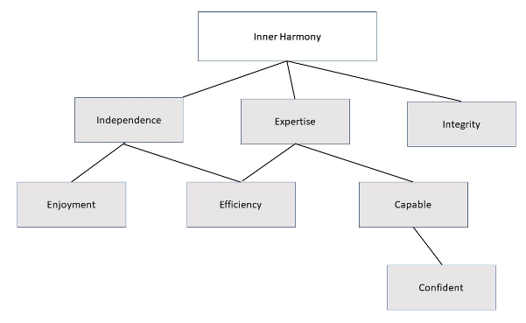
Michael Oliveira

Slide 57
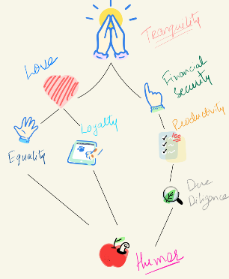
Abhishek Rakesh Shah

Slide 59
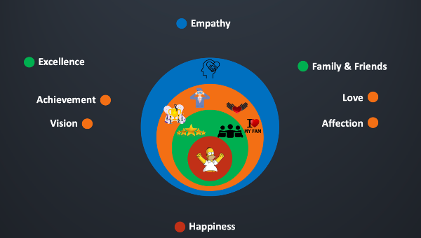
Rajesh Rengarajulu

Slide 61
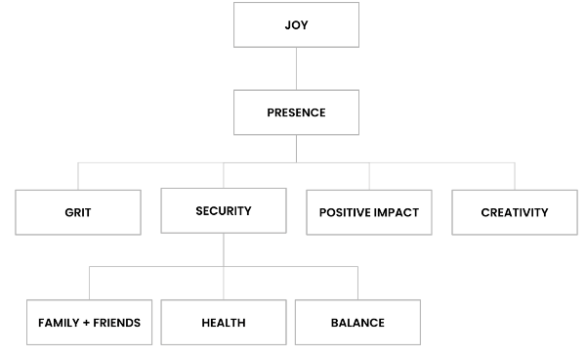
Christina Riggio

Slide 63
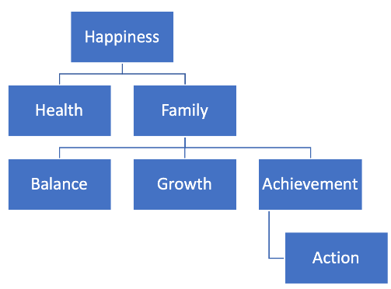
Ty Rosa

Slide 65
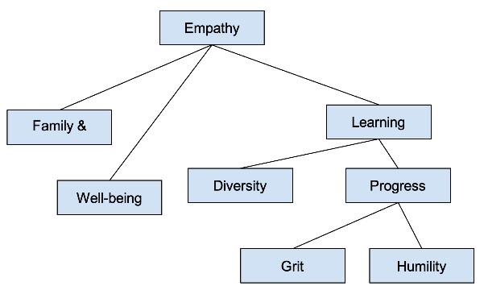
Girija Vidhate

Slide 67
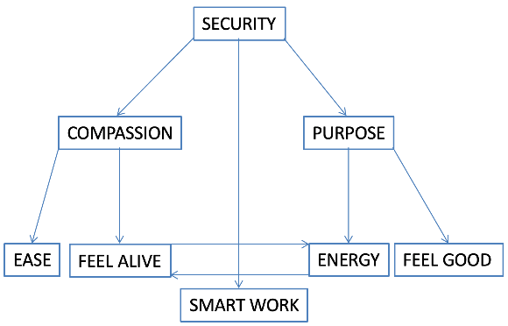
Junyan Wu

Slide 69
Elijah Heyward
Self Awareness
Curiosity
Service
Beauty
Relationships
Moral Courage
Grit
Justice

Slide 71
Piyush Pruthi
Well being
Reflection
Relationship
Reward
Empathy
Perseverance
Adventure
Collaboration

Slide 73
Meghan Xu
Serenity
Love
Wealth
Freedom
Openness
Accomplishment
Adventure
Resilience

Slide 75
Sebastian Mutimer
Harmony
Being present
Responsibility
Curiosity
Honesty
Mentoring
Change
Playfulness

Slide 77
Giacomo Garancini
Growth
Curiosity
Ambition
Focus
Creativity
Social Development
Creativity
Collegiality

Slide 79
Bill Catucci
Peace
Competence
Motivation
Stimulation
Feeling confident at my craft
Family & Legacy
Doing purposeful work
Commitment
Affection
Action
Love

Slide 81
Thomas McInerney
Bliss
Gratification
Character
Relationships
Grit
Wisdom
Charity
Golden rule

Slide 83
Rishabh Raj
Adventure
Wealth
Financial security
Challenge
Edge
Productivity/Winning
Basic comfort
Thinking

Slide 85
Derek Fake
Love
Beauty
Goodness
Truth
Greatness
Openness
Stability
Commitment

Slide 87
Tejasvi Samala
Family
Giving
Financial security
Empathy
Fairness
Patience
Ease
Success

Slide 89
Daniel Bishop
Happiness
Legacy
Maximize Income
Relationships
Productivity
Corporation
Patience
Knowledge
Organization
Discipline
Intellectualism
Education

Slide 91
Scott Lyons
Kindness
Serenity
Connection to
the universe
Work-life
balance
Discipline
Development
Financial
Security
Relationships

Slide 93
Joseph Pitsor
Actualization
Success
Love
Health
Family
Flexibility
Adventure
Make a difference
Energy
Wellbeing
Education

Slide 95
Daniela Wambold
Integrity
Success
Dedication
Responsibility
Kindness
Support
Motivation
Accomplishment

Slide 97
Stephanie Barimah
Connected to the Universe
Balance
Excellence
Love
Impact
Wealth
Achievement
Health
Gratitude

Slide 99
Miku Hagihara
Stability
Family
Purpose
Respect
Validation
Opportunity
Integrity
Grit

Slide 101
Kathy Lim
Inner peace
Faith
Love
Excellence
Passionate
Warmth
Respect
Gratification

Slide 103
Aditya Sistla
Happiness/ Pure joy
Family & Relationships
Optimism
Confidence
Dreams
Discipline
Reward
Serenity

Slide 105
Engels Obi
Fulfillment
Valued
Achievement
Relationships
Reliability
Growth
Give back
Financial Security

Slide 107
Daniel Singh
Happiness
Self-Esteem
Loyalty
Persistence
Dedication
Support
Accountability
Reward

